Slide 1
Pay by Card Program Analysis| Economics, Trends, and Segmentation Opportunities
SCOPE & APPROACH
ASSUMPTIONS & LIMITATIONS
This analysis examines 2,000 completed Pay by Card transactions spanning December 13 2025 to March 12 2026. The goal is to explain program economics, identify volume trends, and surface customer segmentation opportunities that can inform decisions across Customer Success, Sales, and Product teams.
1
Dataset contains completed transactions only failed and reverted payments were not included, so full funnel metrics such as card penetration rate cannot be calculated
December 2025 and March 2026 are partial months, MoM growth references January and February only. Extended trend analysis was not performed given only two complete months are available
Three cashback rate bands identified from derived cashback rate column (0.25%, 0.50%, 0.75%+) indicating a tiered pricing structure. Irregular decimal values also observed, likely reflecting fixed-amount cashback arrangements
2
15 DAX measures and 9 derived columns created in Power BI from the provided dataset. Google Sheets was used for sanity checks verifying that column totals matched Power BI KPI values, and confirming that gross interchange reconciled against net interchange, cashback, and processing cost across sampled rows.
Key measures: Total Card Spend, Implied Interchange Rate (gross interchange ÷ payment amount), MoM Spend Growth, Avg Processing Days (transaction date − payment created date), and Cashback Yield %. Key derived columns: Processing Cost, Cashback Rate and Tier (revealed three pricing bands: 0.25%, 0.50%, 0.75%+), Size Category, and Month-Year label. Working file submitted as Power BI .pbix.
3

Slide 2
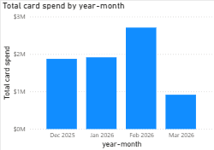

$7.42M processed across 2,000 transactions| February grew 41.5% driven by broader industry participation
Payment Volume Trends
$7.42M
2,000
$3.71K
Total Card Spend
Transactions
Avg Transaction
All 4 months
Completed payments
Per payment
January to February card spend increased 41.5%, transaction count grew 31% and average transaction size grew 8%. MoM growth is calculated between January and February only as the two complete months in the dataset, December and March are partial months and excluded from this calculation to avoid distortion from unequal time periods

Slide 3
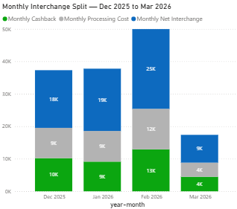
Every $100 in card spend generates $1.92 in interchange | retains 49.5 cents of every dollar earned
Revenue Economics | Interchange Generation & Distribution
1.92%
0.50%
49.5%
Interchange Rate
Cashback Yield
Net Margin
Gross revenue per $ spent
Customer return per $ spent
Of gross interchange retained
Per $100 Card Spend
Gross Interchange earned
$1.92
Cashback paid to customer
−$0.50
Processing cost absorbed
−$0.48
Net retained
$0.94
Interchange economics remain stable across all four months, net margin holds consistently at approximately 49.5% regardless of volume fluctuations. February's higher total interchange reflects volume growth, not a rate change, confirming that revenue scales predictably with card spend

Slide 4
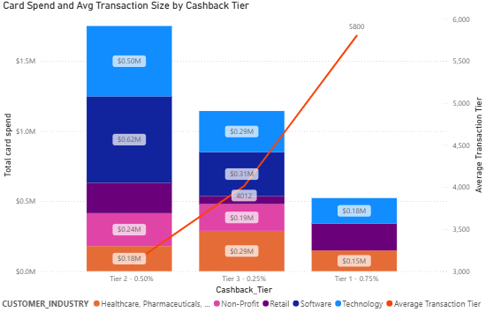
High tier cashback customers generate 93% larger transactions, premium cashback is exclusively observed in Large customer accounts
Customer Segmentation | Three Cashback Tiers & Customer Size Distribution
Three cashback rate bands identified from derived cashback rate column (0.25%, 0.50%, 0.75%+). High tier cashback appears exclusively in Large customer accounts across all 2,000 transactions, whether this reflects volume commitments or negotiated pricing cannot be confirmed from transaction data alone, but suggests Mid-size customers may have limited access to premium cashback incentives.
$5.8K
Tier 3 Avg transaction
vs $3k standard tier (+93K)
$807K
Tier 3 Total card spend
Exclusively from large customer, no small-mid
Despite paying higher cashback (0.75% vs 0.50%), High tier transactions generate nearly double the net interchange per transaction, $54 vs $28, because larger invoice sizes ($5.8K vs $3K) produce proportionally more gross interchange revenue. Higher cashback and higher net revenue are not in conflict for this tier

Slide 5
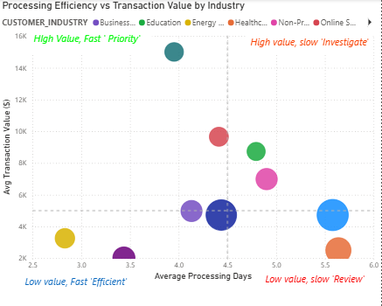
Telecommunications generates 4x higher transaction values than Retail with faster processing and stronger interchange economics
Revenue Driver Analysis | Processing Efficiency & Merchant Mix
Telecommunication- Priority
$14-16K avg transaction, 3.8 days processing. Highest interchange per transaction in the dataset.
Merchant Rates - Consistent
All categories 2.6%–3.0%. Volume and transaction size are the primary revenue levers — not merchant mix.
Technology - Review
Technology drives the highest card spend ($978K) but shows 5.58 day processing and $4,724 avg transaction, the largest efficiency gap relative to its volume contribution.
Telecommunications processes $15K transactions in under 4 days, the most efficient profile in the program. Technology, despite driving the highest card spend at $978K, takes 5.58 days to process $4.7K average transactions. Product and Engineering should investigate what is causing this delay, resolving it for the program's highest-volume industry represents the largest absolute efficiency opportunity without requiring new customer acquisition.

Slide 6
Three actions to grow interchange revenue without new customer acquisition
Customer Success
Sales
Product
Unlock hidden eligible spend in Standard tier accounts
Prioritize Telecommunication and Healthcare verticals
Investigate Technology processing delay
Mid-size customers represent an estimated $817K in monthly card spend. Approximately 35% (~$286K) is estimated to be on Low tier based on overall tier distribution. If these customers converted to High tier and exhibited the same 16% transaction size premium observed in existing High tier customers, monthly spend from this segment would increase to $331K, generating an estimated +$864 in gross interchange and +$428 in net interchange per month. This represents incremental revenue from ACH displacement, payments currently going through wire or ACH that could be routed through card with the right cashback incentive
Telecommunications generates $15K average transaction values with the fastest processing at 3.95 days, the most efficient PBC profile in the dataset. Prioritizing this vertical in new customer acquisition improves program economics disproportionately to the number of customers added.
Build a targeted outreach list of Large customers in Telecommunications, Healthcare, and Technology verticals for High tier cashback onboarding packages
Technology drives the highest card spend at $978K but shows 5.58 day average processing , the largest efficiency gap relative to volume contribution. Resolving this processing friction for the program's highest-volume industry would have the greatest absolute impact on overall program efficiency
Complete investigation into Technology industry processing delay (5.58 days vs 3.95 days benchmark) and implement fixes by Q4 2026, resolving the largest efficiency gap relative to volume contribution.

